Slide 1

Unit 8

Slide 2
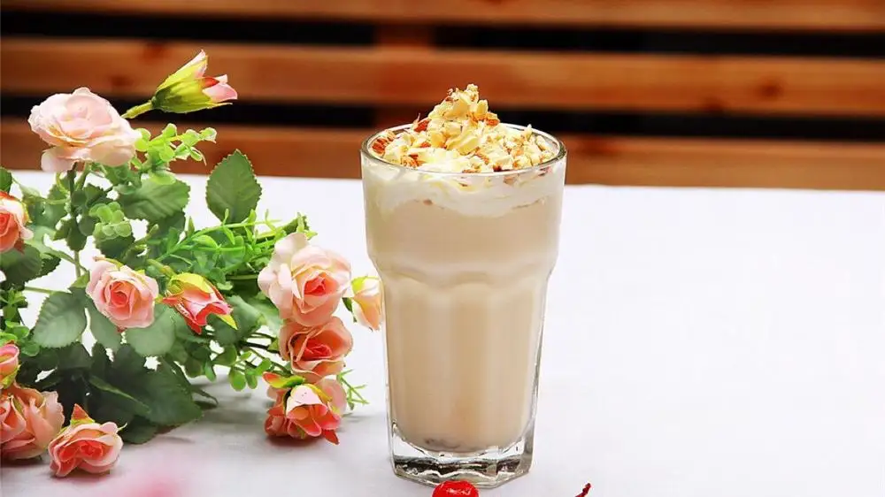
Unit 8
How do you make a banana milk shake?

Slide 3
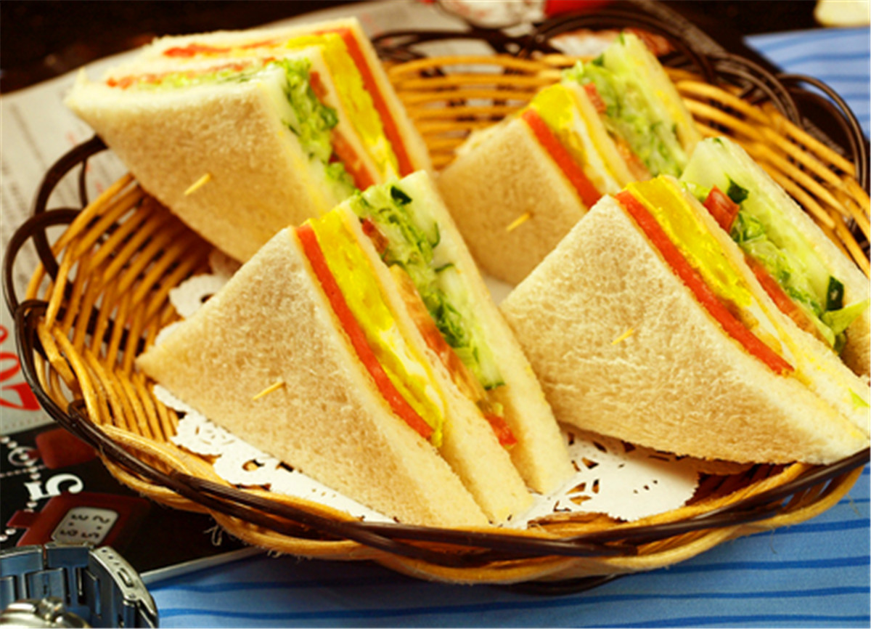


Slide 4



To talk about the ingredients of sandwich you like
To learn to describe the process of making sandwich using “First, Then, Next, After that, Finally”
To learn the new words: sandwich, butter, turkey, lettuce, piece

Slide 5



Match the food with how many or how much.
1. milk 2. tomato 3. teaspoon
4. popcorn 5. yogurt 6. salt
7. apple 8. onion 9. dumpling
10. milk shake 11. juice 12. meat
13. cup 14. porridge 15. watermelon
16. mutton
how many
how much

Slide 6

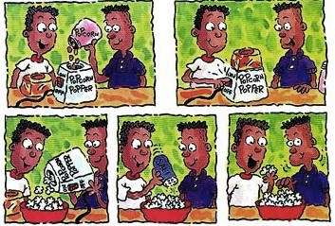
How do you make popcorn?
First, put half a cup of corn into the popcorn machine.
Next, turn on the machine.
Then, put the popcorn into a bowl.
Finally, add some salt. You can eat it.

Slide 7


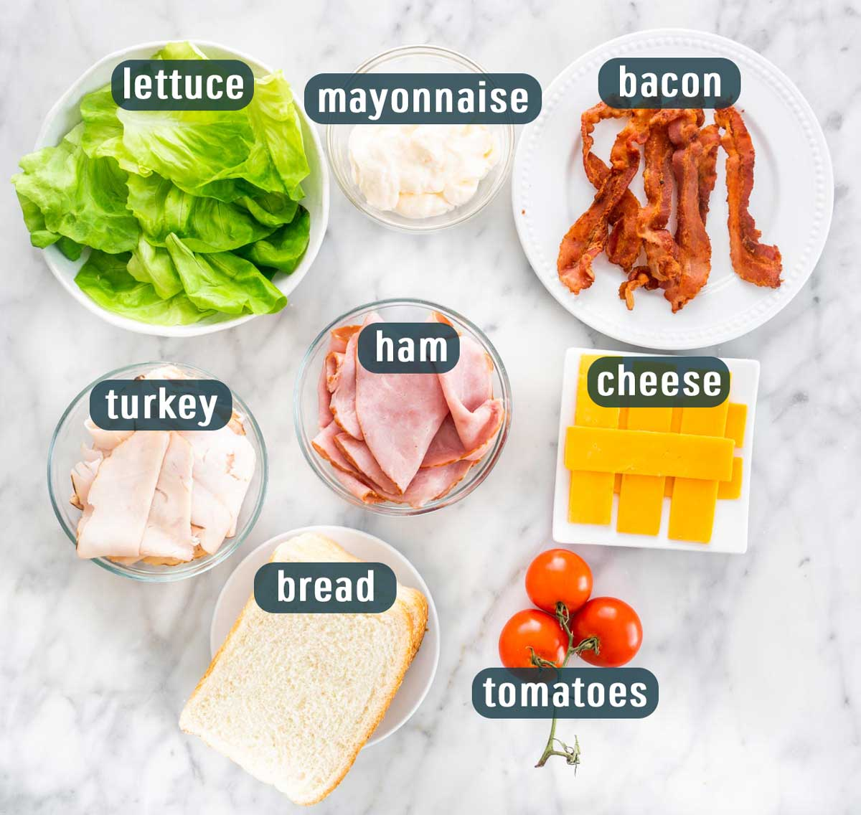
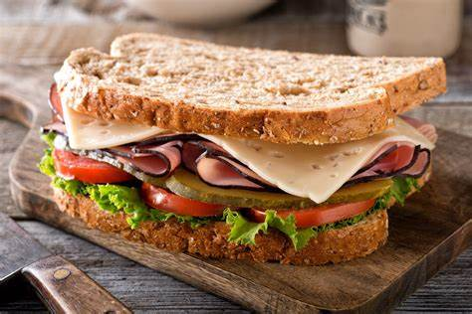
n. 夹心面包片；三明治
Do you like sandwiches?
What kind of sandwiches do you know about?
What can we put in a sandwich?

Slide 8

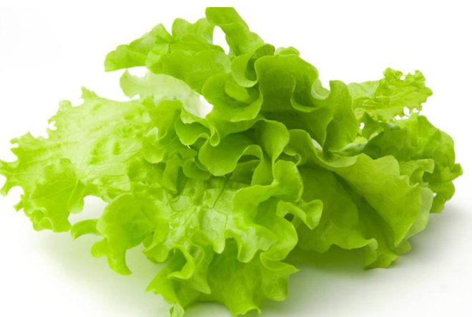
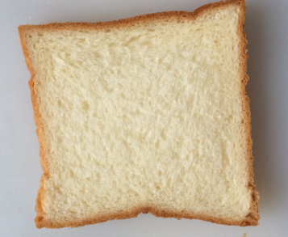
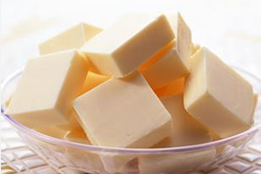
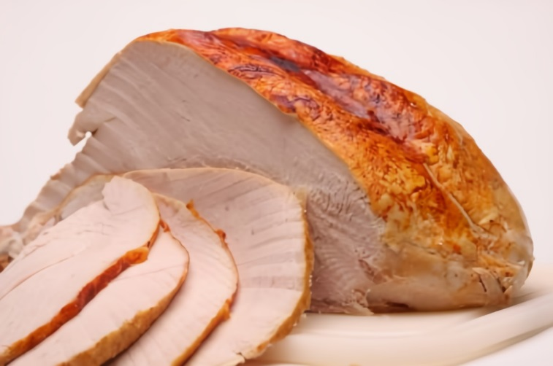
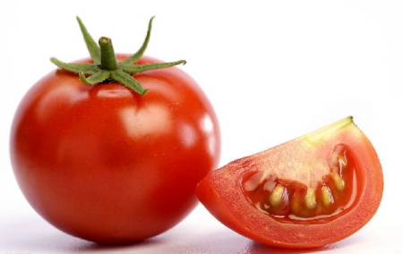
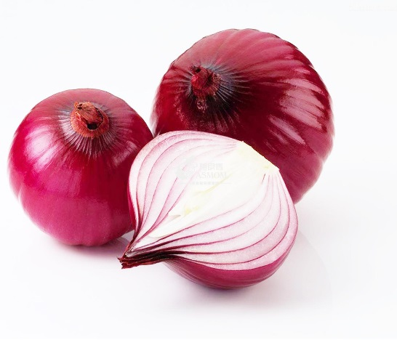
What do you like to put in your sandwich?
butter n. 黄油; 奶油
lettuce n. 莴苣; 生菜
bread
onion
tomato
turkey n. 火鸡

Slide 9
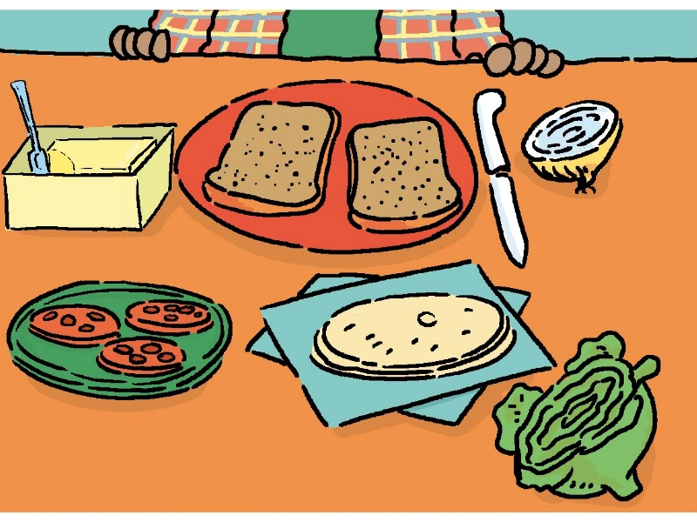
Make a list of the things you like in a sandwich.
In my sandwich, I like __________________________________________
bread, butter, tomato, lettuce, turkey, onion …
bread
onion
butter
turkey
tomato
lettuce

Slide 10

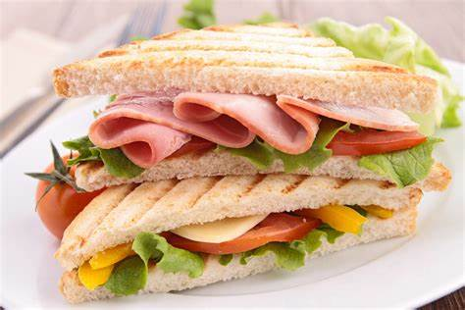
Ask and answer questions with a partner. Find out what he / she likes in a sandwich.
A: Do you like lettuce in a sandwich?
B: Yes, I do.
A: Do you like tomatoes?
B: No, I don’t.

Slide 11


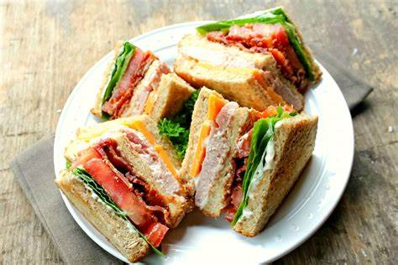
A: Do you like … in your sandwich?
B: …
A: What about …?
B: …
cheese sandwiches

Slide 12



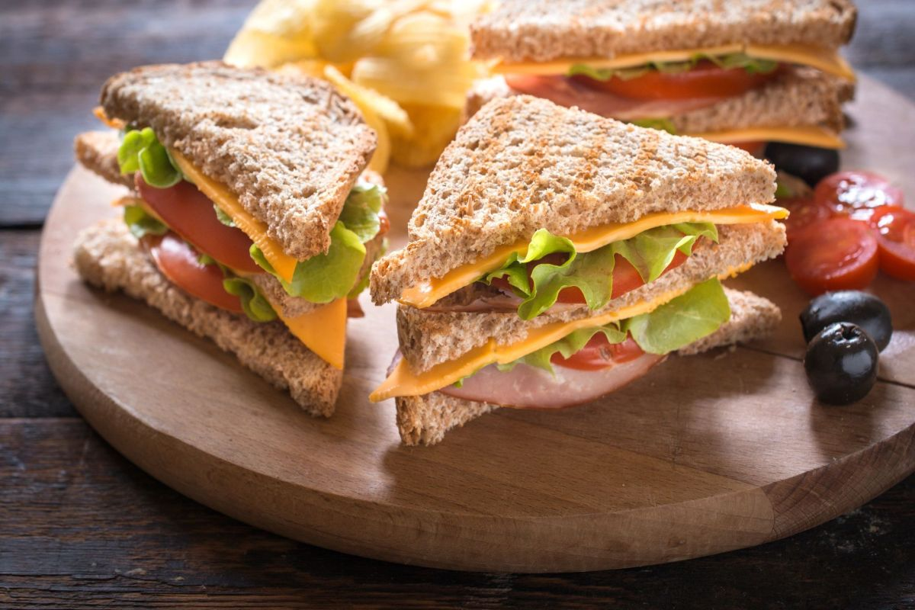
I like cheese sandwiches.
How to make a cheese sandwich?
First, …
Next, …
Then, …
Finally, …

Slide 13



Look at the picture in 1a. Listen and circle the words you hear.
bread
onion
butter
turkey
tomato
lettuce

Slide 14

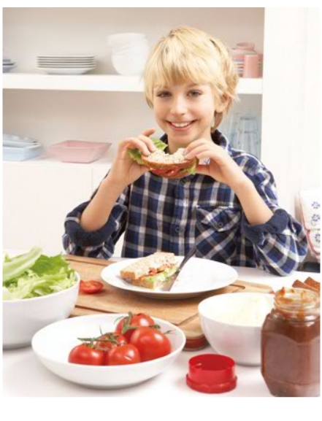


Listen again. Write the ingredients in the order you hear them.
First | Next | Then | Finally
butter
tomatoes
bread
onion
lettuce
bread
cheese
关注听力中表示顺序的关键词：first, next, then, finally。

Slide 15
Listen again and fill in the blanks.
Girl: How do you make a cheese sandwich?
Boy: Well, first put some butter on ______________bread.
Girl: How much butter?
Boy: Oh, about ___________.
Girl: OK. What else?
Boy: Next, cut up some tomatoes.
Girl: __________ tomatoes?
Boy: Well, maybe one is enough. Put the tomato on the sandwich. Next, cut up an ________.
a piece of
piece n. 片; 块; 段
one spoon
How many
onion

Slide 16
Girl: Sounds good. What about the cheese?
Boy: Next, put some cheese on the sandwich.
Girl: __________ cheese?
Boy: Not too much, but you can put ________ if you like.
Girl: OK. Is that all?
Boy: Not quite. Then, put some lettuce on the cheese.
Girl: Sounds delicious!
Boy: Finally, put _________________ bread on top.
Girl: Great!
How much
more
another piece of

Slide 17

First, put some butter on a piece of bread.
Finally, cut the turkey into thin pieces and ...
piece n. 片
piece常用于表示不可数名词的量，可意为“片；块；张；条 ……”。
常用结构：a / another / 数词 + piece(s) of + 不可数名词
e.g. a piece of cake 一块蛋糕
another piece of meat 另一块 / 片肉
two pieces of advice 两条建议

Slide 18
【语境应用】完成句子
1) 你想再吃一块蛋糕吗？
Would you like to eat _______ _______ _______ ______?
2) Lucy把肉切成了小块。
Lucy cut the meat into _______ _______.
another piece of cake
small pieces

Slide 19
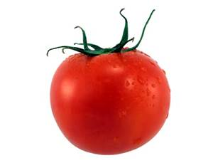
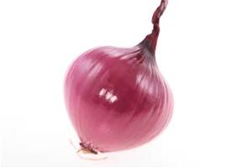
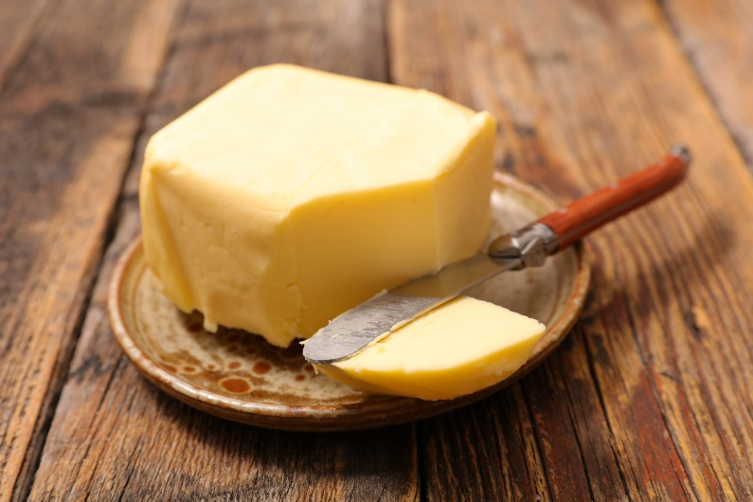
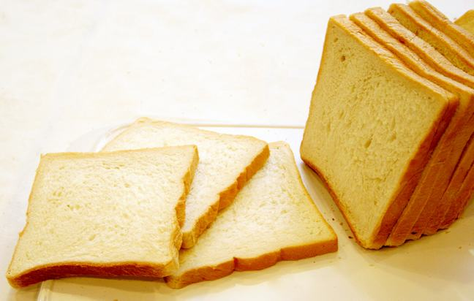
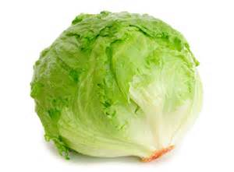
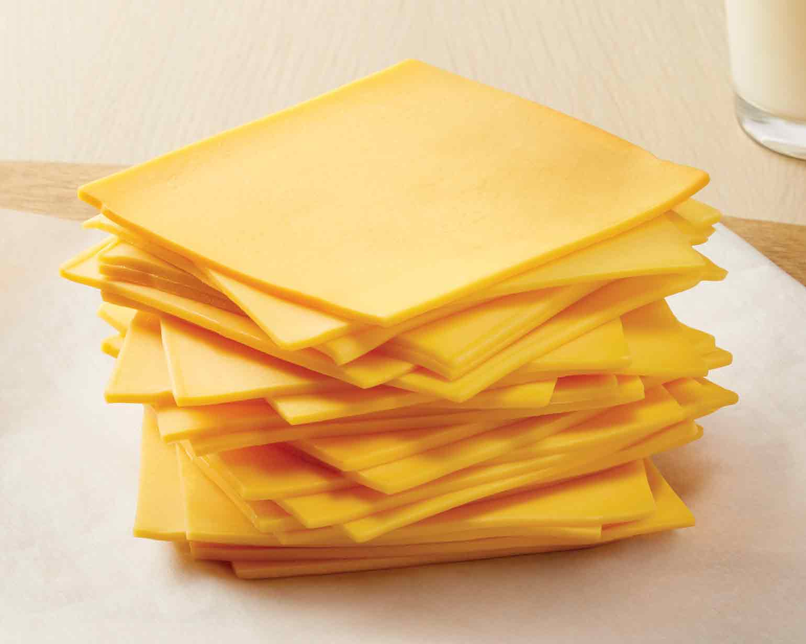
Let’s study how to make a cheese sandwich.
ingredients
pieces of bread
tomato
butter
onion
cheese
lettuce

Slide 20
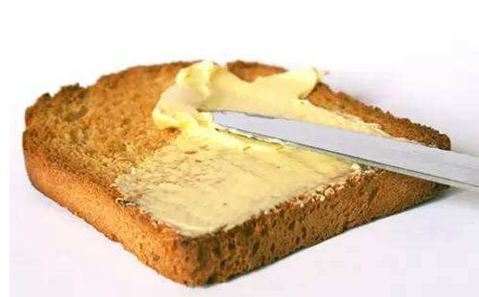

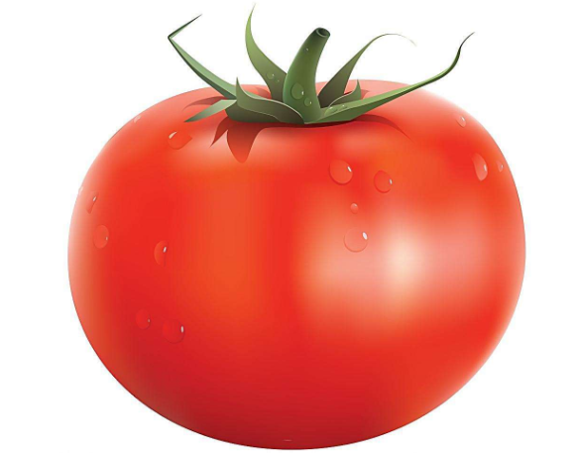
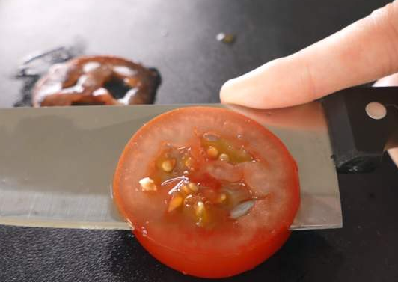
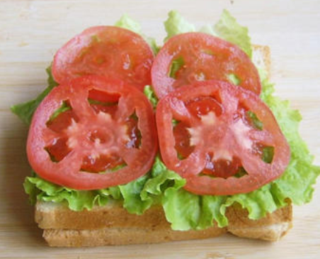
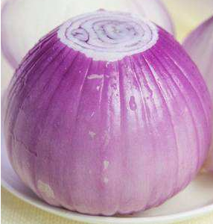
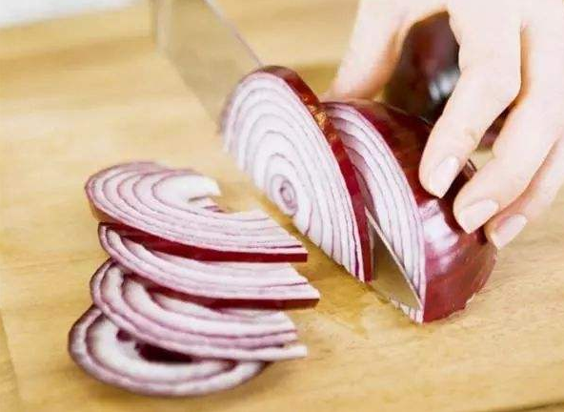
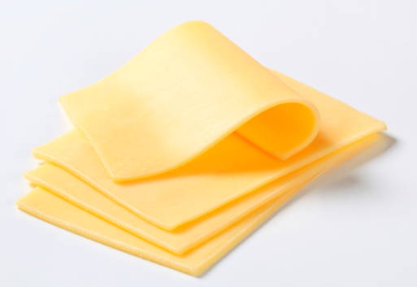
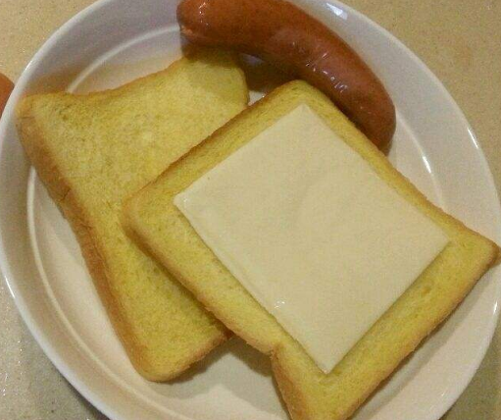
First
put some butter on a piece of bread.
cut up one tomato.
Put the tomato on the sandwich.
Next
Next
cut up an onion.
Next
put some cheese on the sandwich.

Slide 21
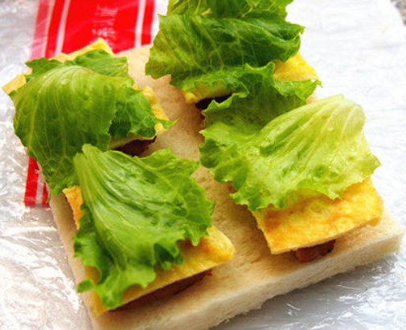
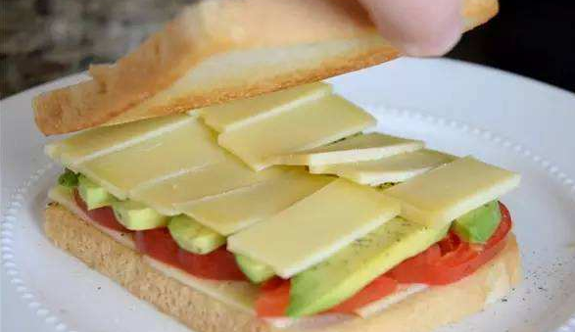

Then
put some lettuce on the cheese.
Finally
put another piece of bread on top.

Slide 22



Tell your partner how to make your favourite sandwich.
A: First, put some butter on a piece of bread.
B: How much butter?
A: About one spoon.

Slide 23


根据短文内容、所给首字母提示及括号内所给单词的提示填空。
Can you make a delicious turkey sandwich? I will tell you how to make one.
B (1) you begin your work, make sure that you have all the ingredients. You need some bread, (2)________ (onion), butter and so on. F (3), you should put some (4)________(butter) on two pieces of bread. Then, cut up a tomato and an onion.
Before
onions
First
butter

Slide 24
A (5) that, put them on the bread. N (6), add two slices (薄片) of (7)________(turkey). Finally, add two (8)________ (spoon) of relish (调味品) to the turkey. Now you can enjoy the delicious turkey sandwich.
After
Next
turkey
spoons

Slide 25


How do you make your favourite sandwich? Please write down and share with your classmates.
First, …
Then, …
Next, …
Finally, …

Slide 26
